Slide 1
Instructions In this experiment, you need to segment the gray bar according to the target percentage. For example:
Line Segmentation Game
Trial 1/100
Segment the bar according to the target percentage:
Target: 70%
70%
Entire bar length 100%

Slide 2
In the beginning you will receive feedback regarding your success. The actual result is marked in green and your response is marked in white
Line Segmentation Game
Trial 1/100
You clicked 73%
Target: 70%
70%
You clicked here
True result
(70%)
Your response
(73%: good enough!)

Slide 3
If your result is accurate enough, the bar will turn green.
Line Segmentation Game
Trial 1/100
You clicked 73%
Target: 70%
70%
True result
(70%)
Your response
(73%: good enough!)

Slide 4
If your result is not accurate enough the bar will turn red, and you will have another opportunity to correct your response. You can correct your responses up to three times.
Line Segmentation Game
Trial 1/100
You clicked: 30% This is not accurate enough. Let's try again.
Target: 70%
70%
Your response
(30%)
True result (70%)

Slide 5
At a later stage in the experiment, you will no longer see the correct result, but only your response. Note that there is a time limit of 15 seconds for every trial. Good luck! We will now start the experiment
Line Segmentation Game
Trial 5/100
Trial OK.
Approximated feedback
Target: 30%
Your response

Slide 6
SCREENSHOTS

Slide 7
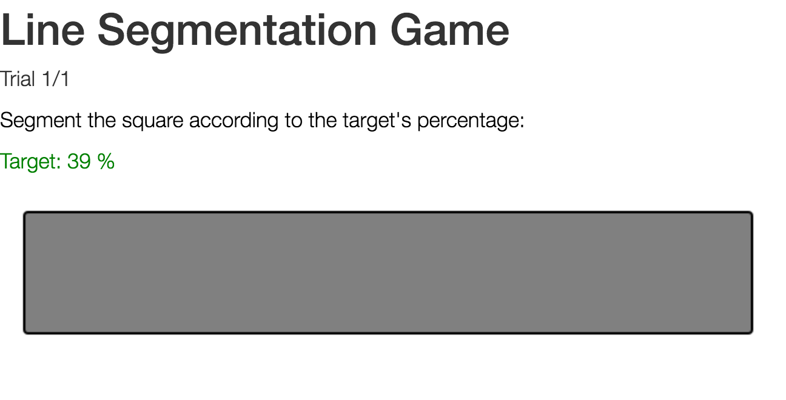

Slide 8
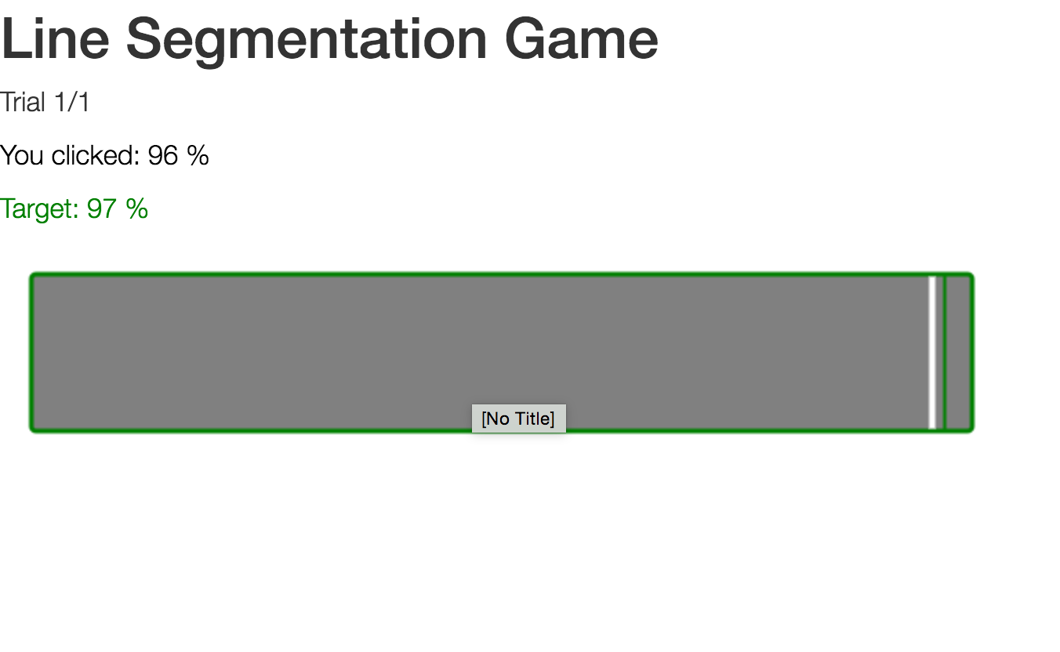

Slide 9
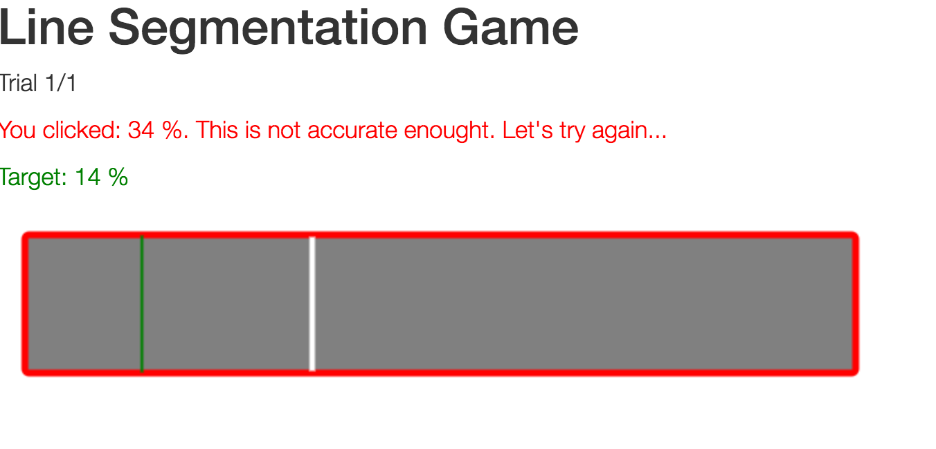

Slide 10
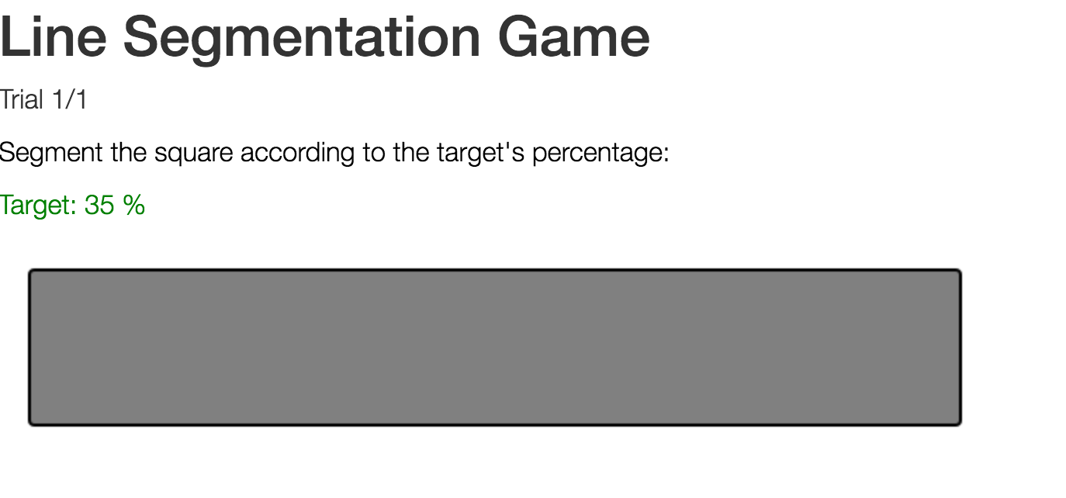

Slide 11
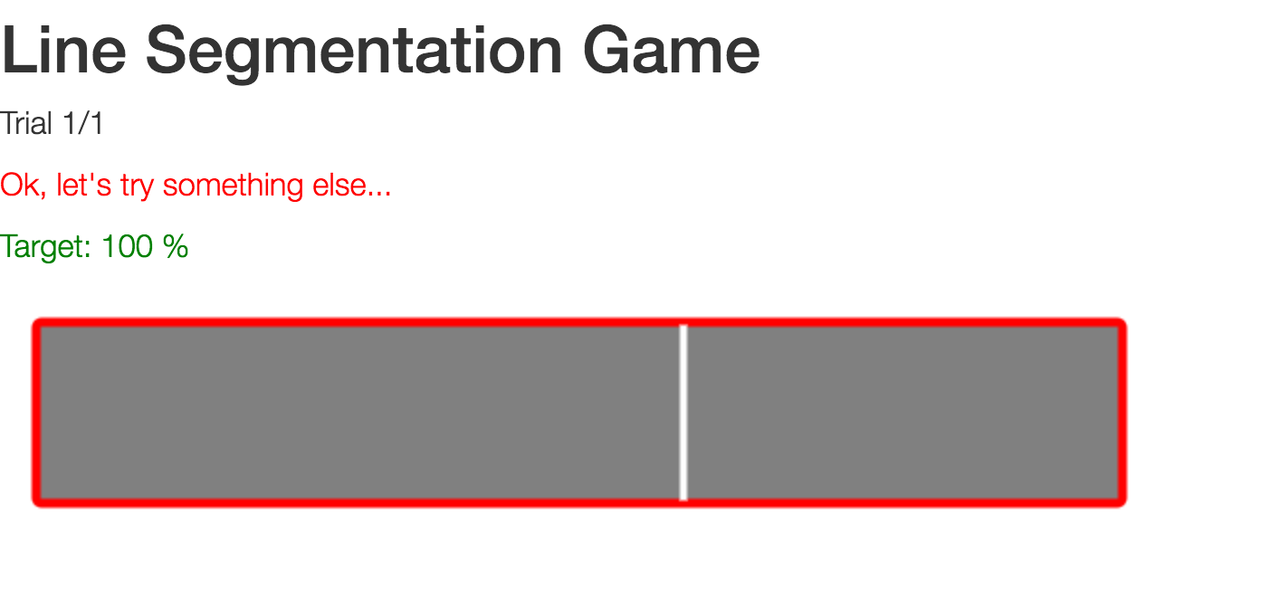

Slide 12
